Slide 1
Sleep Stage Classification Using EEG signals
BDHSC Case Competition 2024
Session 1
Hungry Stayers
1/27/2024

Slide 2
Objective
Goal: develop a model to classify segments of EEG signals into three sleep stages (classes)
Dataset:
Dataset has signals collected at 500Hz frequency for 8 animals that have each undergone 2 discrete 24-hour recordings,
Each 10-second segment is defined as an epoch, containing 5000 data points, recorded in a row, labeled with sleep stage,
Resulting in 16 files each consisting of 8640 rows and 5001 columns
Challenge: large size of dataset causing slow computation
138240 samples (rows) x 5001 features (columns)

Slide 3
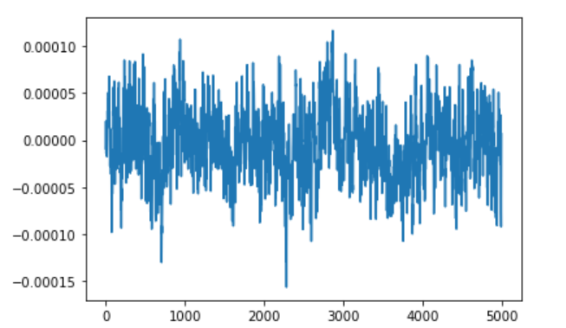
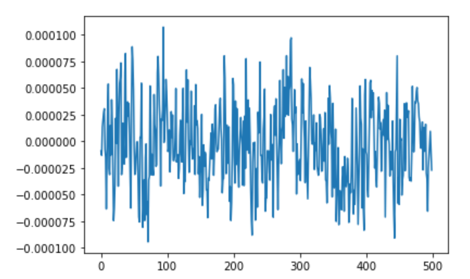
Pre-processing: column reduction
To speed up computation, we reduced the frequency of the data from 500Hz to 50Hz, by uniformly sampling 1 data point from every 10 data points.
Resulting in 500 columns per epoch. The graphs below show the main pattern of the data is reserved after the reduction.

Slide 4
Pre-processing: train-test split
The test set should resemble future data.
We assume the future data to be recordings of new animals.
Consider 2 animals as new (unseen to the model).
Use data for remaining 6 animals to train the model.
Training set: animals 0-5
Test set: animals 6, 7

Slide 5
Methodology
Train different machine learning models on the training set:
Logistic Regression (LR)
K-Nearest Neighbors (KNN)
Neural Networks (NN)
Random Forest (RF)
Recurrent Neural Networks (RNN)
Long Short-Term Memory( LSTM RNN)
Evaluate each model on the test set using metrics:
Accuracy, Precision, Recall
Compare their performance.

Slide 6
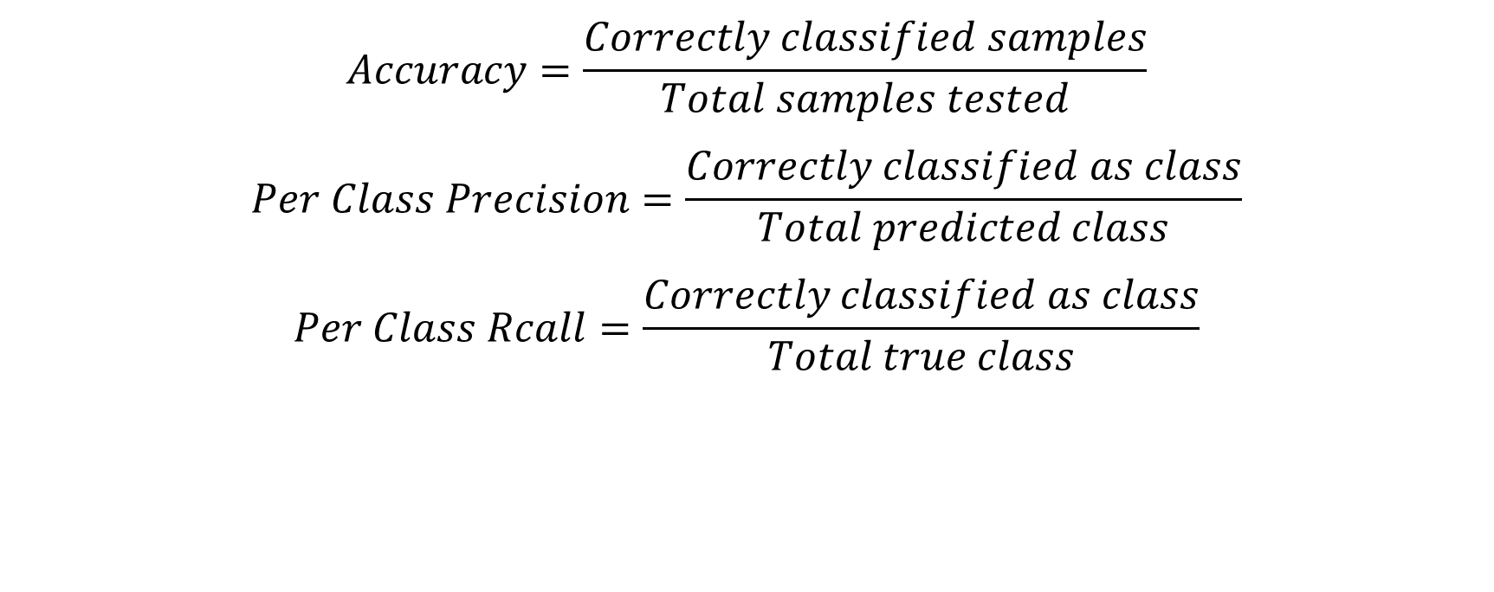
Evaluation
Evaluation metrics are defined as follows:
$$Accuracy=\frac{Correctly classified samples}{Total samples tested}$$
$$Per Class Precision=\frac{Correctly classified as class}{Total predicted class}$$
$$Per Class Rcall=\frac{Correctly classified as class}{Total true class}$$

Slide 7
Logistic Regression
Confusion matrix
Accuracy: 51.38 %
Precision, recall
Computation time: 2.8 sec
 |  | Predicted Class
 |  | Class 0 | Class 1 | Class 2
True Class | Class 0 | 0 | 0 | 1663
 | Class 1 | 0 | 0 | 15071
 | Class 2 | 0 | 0 | 17826
 | Class 0 | Class 1 | Class 2
Precision | 0 | 0 | 0.52
Recall | 0 | 0 | 1

Slide 8
K-Nearest Neighbor
Confusion matrix
Accuracy: 58.87 %
Precision, recall
Computation time: 33.4 sec
 |  | Predicted Class
 |  | Class 0 | Class 1 | Class 2
True Class | Class 0 | 16 | 12 | 1635
 | Class 1 | 3 | 3378 | 11690
 | Class 2 | 55 | 818 | 16953
 | Class 0 | Class 1 | Class 2
Precision | 0.22 | 0.8 | 0.56
Recall | 0.01 | 0.22 | 0.95

Slide 9
Neural Network
Confusion matrix
Accuracy: 53.53 %
Precision, recall
Computation time: 4.9 min
 |  | Predicted Class
 |  | Class 0 | Class 1 | Class 2
True Class | Class 0 | 0 | 4 | 1659
 | Class 1 | 0 | 932 | 14139
 | Class 2 | 0 | 258 | 17568
 | Class 0 | Class 1 | Class 2
Precision | 0 | 0.78 | 0.53
Recall | 0 | 0.06 | 0.99

Slide 10
Random Forest
Confusion matrix
Accuracy: 79.73 %
Precision, recall
Computation time: 6.4 min
 |  | Predicted Class
 |  | Class 0 | Class 1 | Class 2
True Class | Class 0 | 0 | 321 | 1342
 | Class 1 | 0 | 12748 | 2323
 | Class 2 | 0 | 3017 | 14809
 | Class 0 | Class 1 | Class 2
Precision | 0 | 0.79 | 0.8
Recall | 0 | 0.85 | 0.83

Slide 11
Recurrent Neural Network(RNN)
Confusion matrix
Accuracy: 44.24 %
Precision, recall
Computation time: ~18 min
 |  | Predicted Class
 |  | Class 0 | Class 1 | Class 2
True Class | Class 0 | 0 | 334 | 0
 | Class 1 | 0 | 3126 | 0
 | Class 2 | 0 | 5180 | 0
 | Class 0 | Class 1 | Class 2
Precision | 0 | 0.4333 | 0
Recall | 0 | 1 | 0

Slide 12
Long Short-Term Memory( LSTM RNN)
Confusion matrix
Accuracy: 42.82 %
Precision, recall
Computation time: ~18 min
 |  | Predicted Class
 |  | Class 0 | Class 1 | Class 2
True Class | Class 0 | 0 | 334 | 0
 | Class 1 | 0 | 3126 | 0
 | Class 2 | 0 | 5180 | 0
 | Class 0 | Class 1 | Class 2
Precision | 0 | 0.3618 | 0
Recall | 0 | 1 | 0

Slide 13
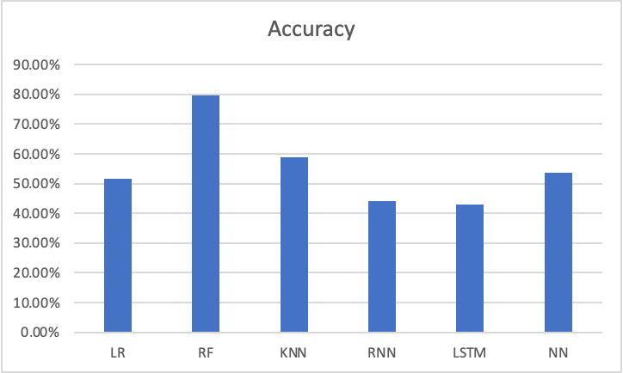
Compare Accuracy
Best accuracy: 79.73 % achieved by Random Forest
2nd best: 58.87 % by KNN

Slide 14
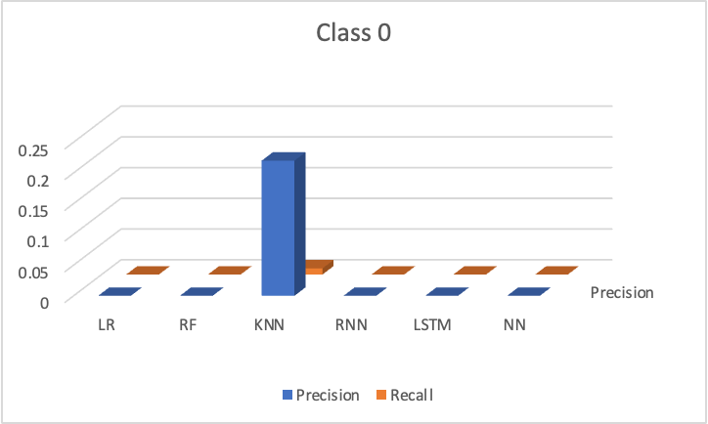
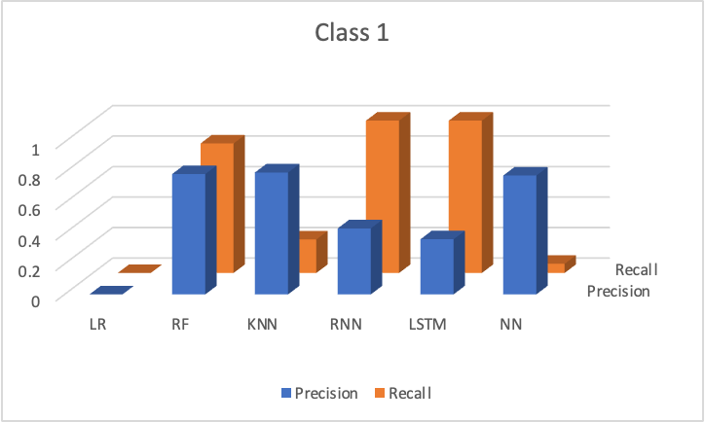
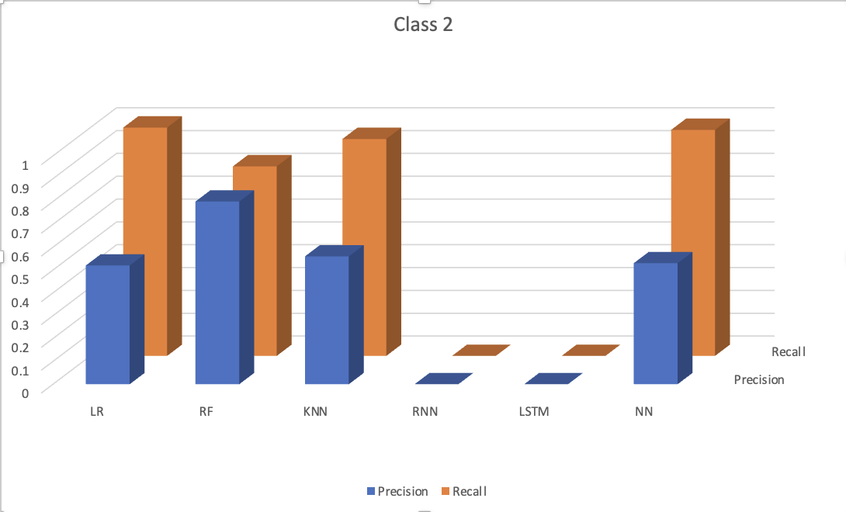
Compare Precision & Recall
Graph here
Best for Class 0: KNN
Best for Class 1: RF
Best for Class 2: RF

Slide 15
Discussion: class imbalance
Most models perform poorly on Class 0.
This can be attributed to class imbalance of the training dataset.
Class 0 percentage: 5.68 %
Class 1 percentage: 43.13 %
Class 2 percentage: 51.19 %
Attempt to mitigate class imbalance problem: Oversampling
We replicated samples from Class 0 and added to the training set.
Result: no better

Slide 16
Discussion: experimental condition
Data is collected under 2 different experimental conditions, denoted by file recording id 0, 1.
This condition may affect data signal patterns and thus affect sleep stage.
Attempt to improve model by considering this condition: Separate models for each condition
We trained models on data for condition 0 and 1 separately.
Result: no better

Slide 17
Conclusion
We built machine learning models to classify segments of EEG signals into three sleep stages.
We reduced the size of the dataset by uniform sampling to reduce training time while keeping the pattern of data.
We held out entire data for 2 animals as test set to represent unseen future data.
We implemented different methods and compared their performance on the test data.
We tried to improve the model by addressing class imbalance and considering different conditions.

Slide 18
Thank you!

